Slide 1
SIDE HUSTLE INTERNSHIP
FRONT-END WEBSITE DEVELOPEMENT
CSS(Cascading Style Sheet)

Slide 2
CSS (Cascading Styles Sheet)
SYNTAX
css selector {
property: value;
}
For example,
Header {background-color: red;}
ADDING COMMENTS IN CSS
/*This is a comment*/
Comments are not visible to our webpage.
It’s make our code easy to read and understand by other developers.

Slide 3
ADDING CSS TO HTML DOCUMENTS There are three ways to add CSS to our HTML file.
INLINE STYLING; adding style inside the HTML tag e.g <h1 style = “color: red;”>This is an example of inline css</h1>
INTERNAL STYLE SHEET; the css rules are included in the <style> element and the <style> element should be enclosed inside the <head> element e.g
<html>
<head>
<title> Internal styling </title>
<style type=“text/css”>
P {color: red;}
</style>
</head>
<body>
<p>This is an example of internal styling </p>
</body>
</html>
EXTERNAL STYLE SHEET; an external style sheet file must be saved with a .css extension and it is linked to the HTML file with the <link> element.
There should be no <style> element inside a CSS file. Here is an example
Body {background-color: brown;}
P {color: red}

Slide 4
CSS SELECTORS
The following are the simple CSS selectors
ELEMENT SELECTORS example: h1 { font-weight: bold;}
CLASS SELECTORS A class selector consist of a dot(.) followed by a class name. example: .underlined-text { text-decoration: underline;}
ID SELECTORS The ID selector is useful when targeting a single element. An ID selector consist of a hash(#) followed by an ID name. example: #blue { background-color: blue;
width: 200px;
}
GROUPING SELECTORS this consists of selectors separated by commas. Example: h1, p {
font-family: sans serif;
color: green;
}

Slide 5
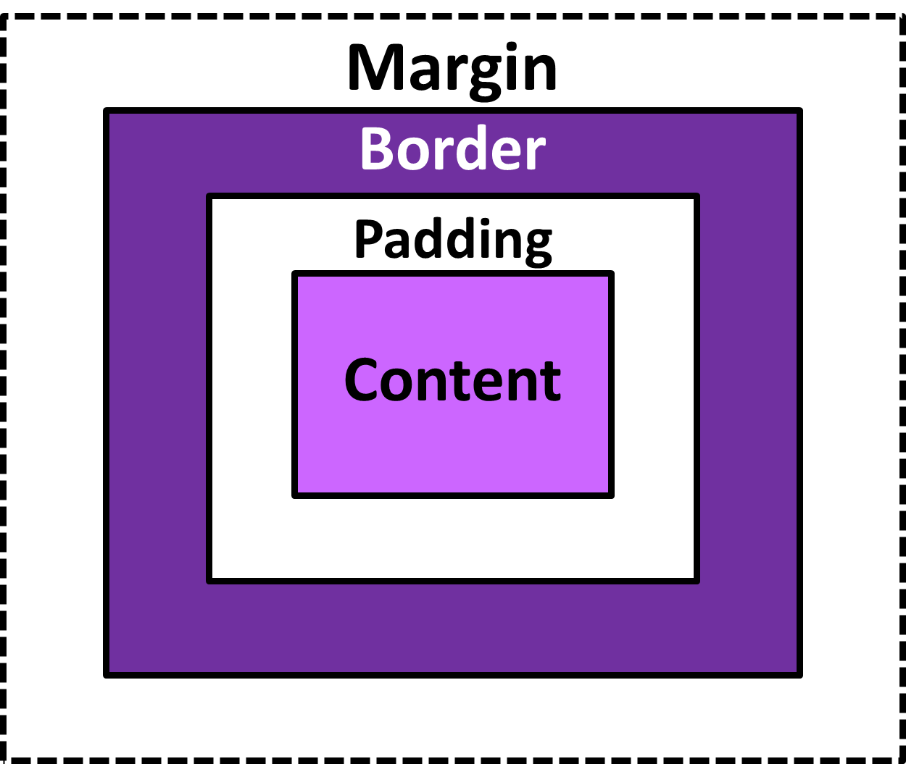
INTERMEDIATE CSS (introduction) BOX MODEL
WIDTH AND HEIGHT OF A CSS BOX
div2 { width: 200px;
height: 200px;
padding: 2opx;
border: 5px solid black;
}
The total width for div2 would be = 5px (left border) + 20px (left padding) + 200px (content box’s width) + 5px (right border) + 20px (right padding) = 250px
The total height for div2 would be = 5px (top border) + 20px (top padding) + 200px (content box’s height) + 5px (bottom border) + 20px (bottom padding) = 250px
In css, each elements is represented as a box with the following parts or properties:
Content: it’s the area where the content of the box is displayed.
Padding: the space or area between the outer edge of the border.
Border: the area between the margin and the padding, it’s properties ca be changed.
Margin: the area or space outside the border or the CSS box.
Example: div1 {
padding: 2opx;
border: 5px solid black;
margin: 40px;
}
Additional resources, visit this link and watch the videos https://drive.google.com/drive/mobile/folders/1wRmX_aCzOAhttxbvfOv23gnLRAVpBiie/1jHOAvbi5brYXkglVEMRJhkr1I5DOz0Ib?sort=13&direction=a

Slide 6
ADVANCED CSS
CSS FORMS
We can style web forms with CSS to make them look attractive.
Removing Outline: input { outline: none; }
Adding Borders: border: 2px solid #0076ff; Adding bottom borders is also good. Border-bottom: 2px solid #0076ff;
Making Rounded Corners: border-radius: 10px;
Changing Texts and Background colors: color: white; background: #0076ff; ::placeholder{ color: white; }
Removing Borders: border : none;
MEDIA QUERIES
Media queries are useful when you want to modify your webpage depending on device types
The @media Rule: here’s the syntax
@media not|only mediatype and (expressions) { CSS-Rules; }
Example:
@media screen and (max-width: 769px) {
body {
background: green;
}
}
In the example above, the background color of the webpage changes to green when the screen size is equal or less than 769px (mobile devices)
Additional resources: visit this link and watch the videos https://drive.google.com/drive/mobile/folders/1wRmX_aCzOAhttxbvfOv23gnLRAVpBiie/18wM5S7p0-PrzCvd9s2OVByBqun7sBroa?sort=13&direction=a

